Slide 1
TRAVEL THE BEST AGENCY
BY:-
AKANKSHA SHAKYA(1307710008)
GAURAV KR. GUPTA(1307710033)

Slide 2
INTRODUCTION
India, one of the most beautiful location of South Asia and is also among the popular countries of the world.
Tourist hub welcomes more than a 5 million tourists from different locations of the world.
A trip to this beautiful country can reveal numerous mystic things regarding its culture , art , tradition , history etc.
Tourists are more attracted towards the cultural diversity of this country from Kashmir to Kanyakumari. Each tradition symbolizes the flavour and aura of the place.

Slide 3
Jammu and Kashmir, Himachal Pradesh, Kullu Manali etc. are famous hill stations of north India.
In the southern part of India , places like Kerela and Goa are famous for the exotic beaches which are a paradise for the tourists .
One of the major tourist attractions in India is TAJ MAHAL which is one of the seven wonders of the world.
Rajasthan a state with numerous scenic sports, majestic forts, pristine lakes, and oasis is a tourist hub as well. One can always plan of Safari through its sun kissed Thar deserts.
Kerala also known as God’s own country is one of the most beautiful states in India , famous for its back waters and serene atmosphere.

Slide 4
PROBLEM STATEMENT
The purpose of this website is established fact that Internet users are increasing today. One of the main purpose of this website is to facilitate the offline customer online because customers cannot spend their precious time in markets trying to find out the best deal.
India is a country where in a few days holiday, you can enjoy a lot. The problem is that we although having many websites but they offer different kind of services .The customers are enjoying a lot but there is a lack of relationship between travel agency and customers and hence we are establishing that relationship by caring and serving all customers in the same manner that we wish to be served.

Slide 5
Our priority will be our customers and their travel requirements.
There will be many users visiting the portal and hence we require a strong and reliable frontend which can withhold the users on our site.
The data we will be consisting is very important that can help everyone and hence we need a strong database.
We need to build a world class team armed with knowledge and backed by technology to advise customers in planning of their holidays and to answer their queries.
We will be putting an effort to provide the right choice to the people when they plan a holiday and beware them from the false advertising.

Slide 6
OBJECTIVE
Our objective is to offer a variety of travel services that are sure to match all customer’s priorities.
Our objective is to globalism, organize, standardize and goal of journey towards perfectionism
Our objective is to make strong relationship with customers so that they can enjoy the holiday of their dreams.
Our objective is just an initiative, it will be made to more further and developed work of art.

Slide 7
PLAN OF ACTION/Methodology
Making of front end.
Creating various table in database as needed.
Connection of front end to back end (connection of forms to database).
Update of candidates details by admin.
Doing respective jobs
Declaring of result

Slide 8
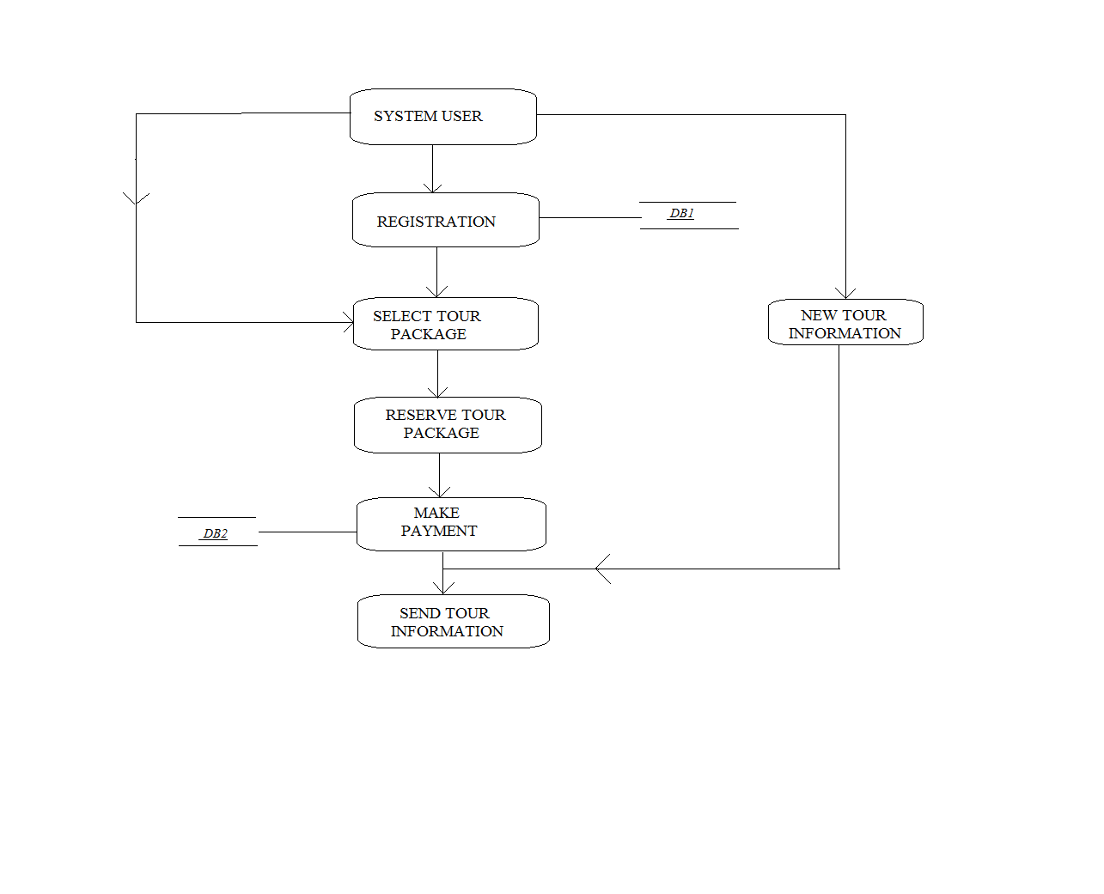
DATA FLOW DIAGRAM

Slide 9
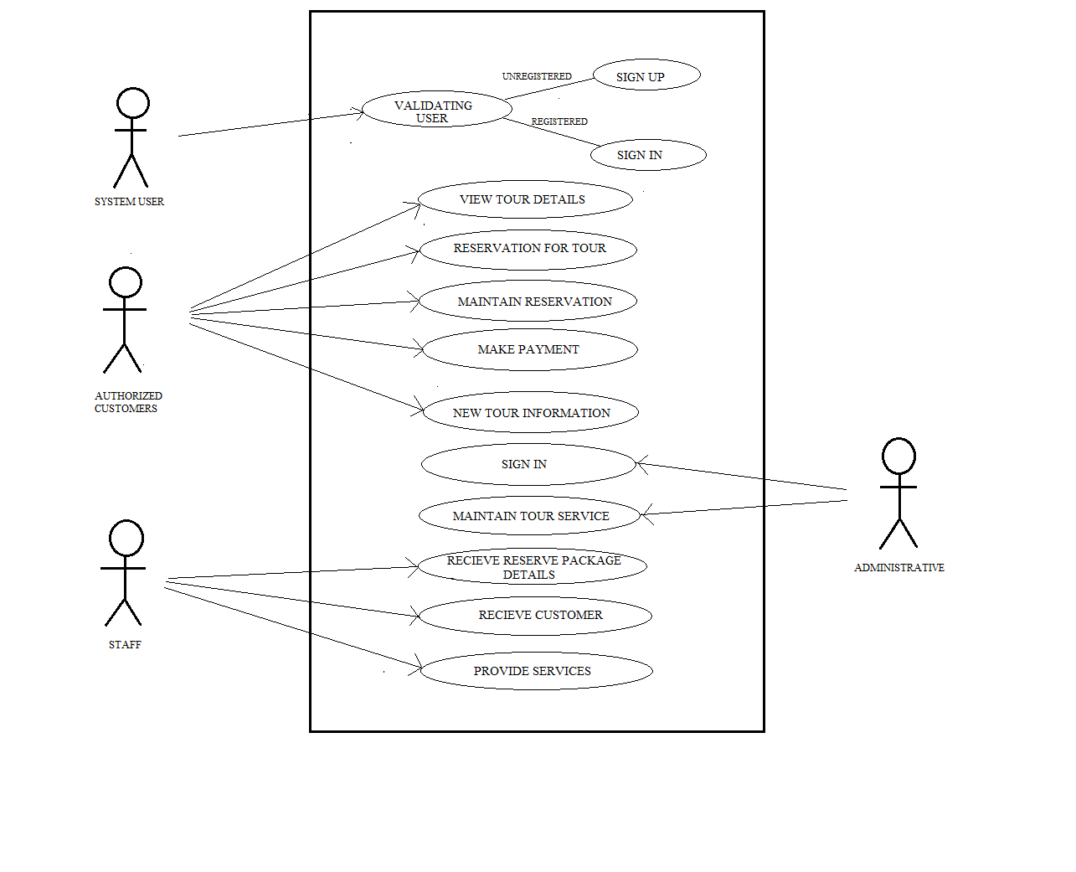
USE CASE DIAGRAM

Slide 10
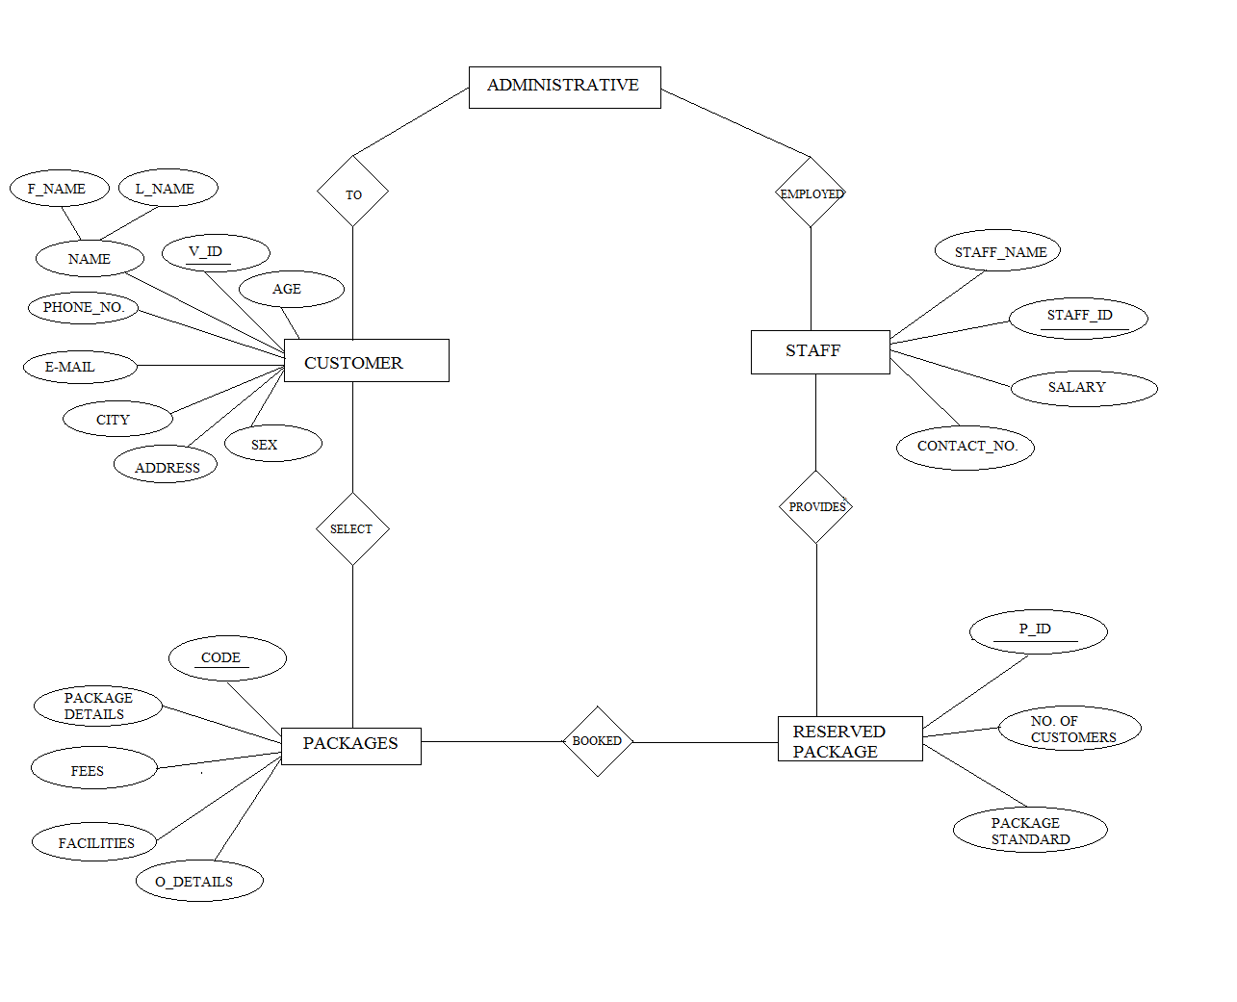
E-R DIAGRAM

Slide 11
PROPOSED SEMESTeR PLAN
In the last semester we were doing designing, and making lay-out of our project.
But in this semester we will present :-
Coding of project.
Add graphics.
Making various database table for information storage.
Launch this website on INTERNET.

Slide 12
MEASURES OF UNIQUENESS
It is very unique compared to other websites because in this we cover all the tourists hubs. Other websites only select famous or limited tourist places.
In this we are providing best staffs who are very caring and hospitable with the tourists and the tourists also enjoy touring with them.
Apart from the available packages we let our customers choose the package which best suits their need.

Slide 13
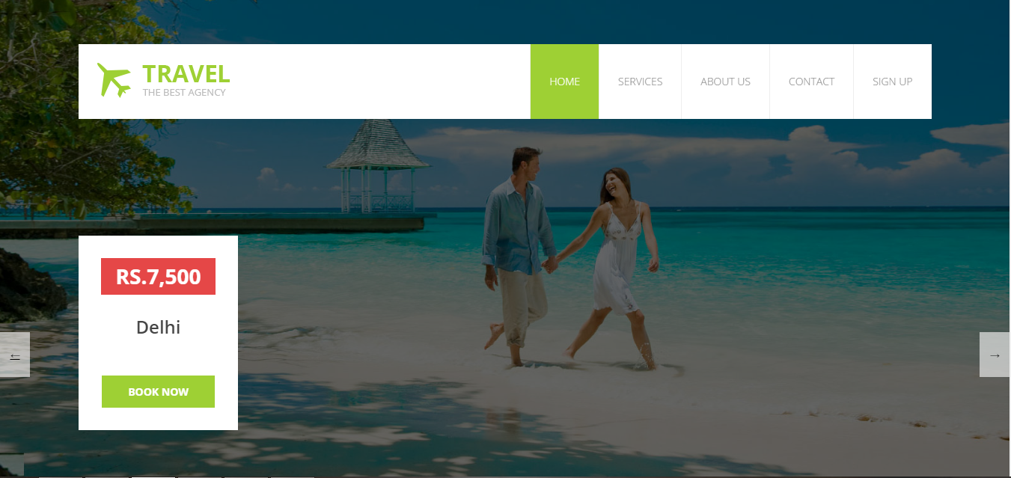
Snapshots of project Home page (i)

Slide 14
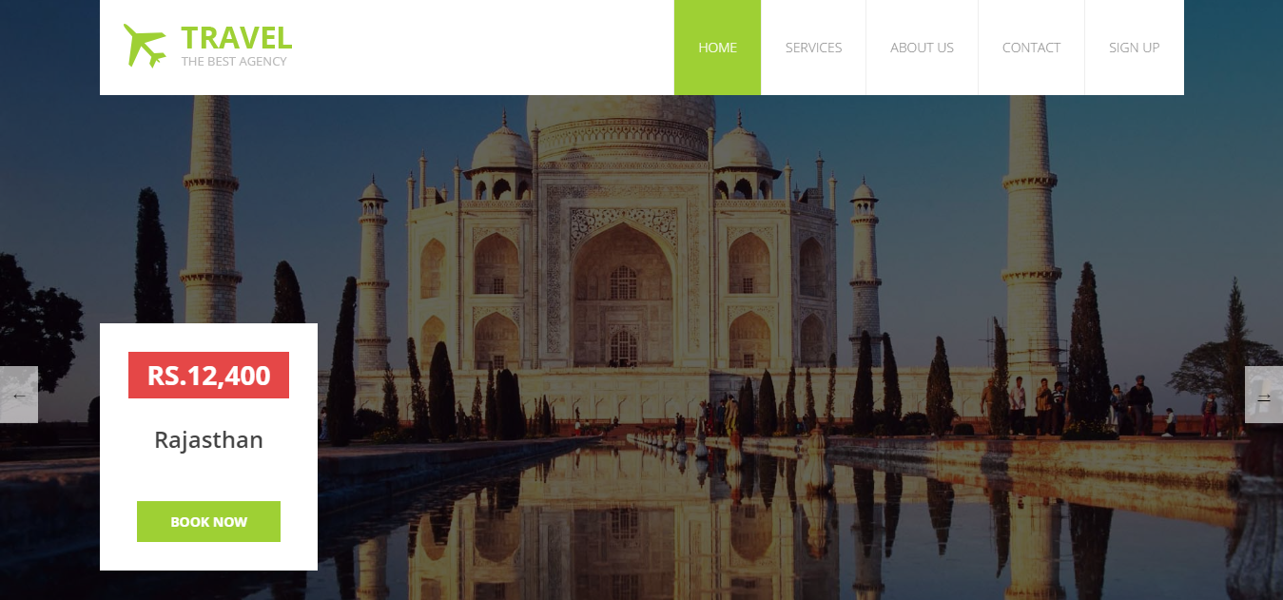
Home page(ii)

Slide 15
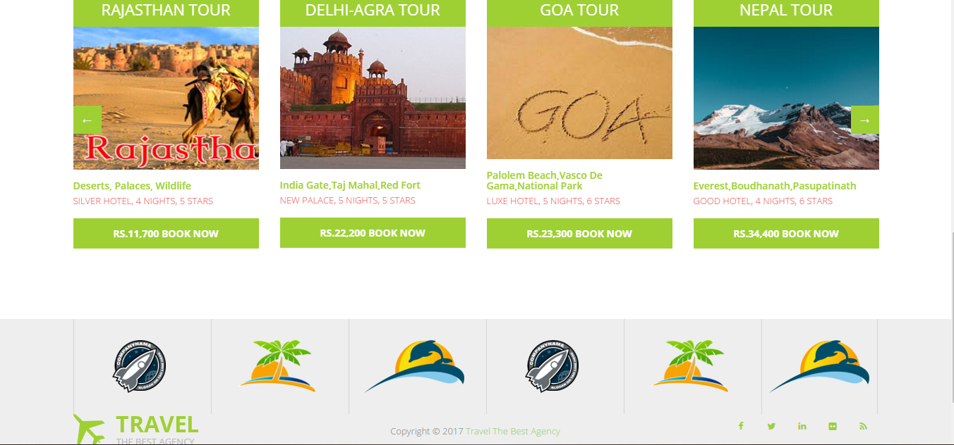
Tour pacakges(i)

Slide 16
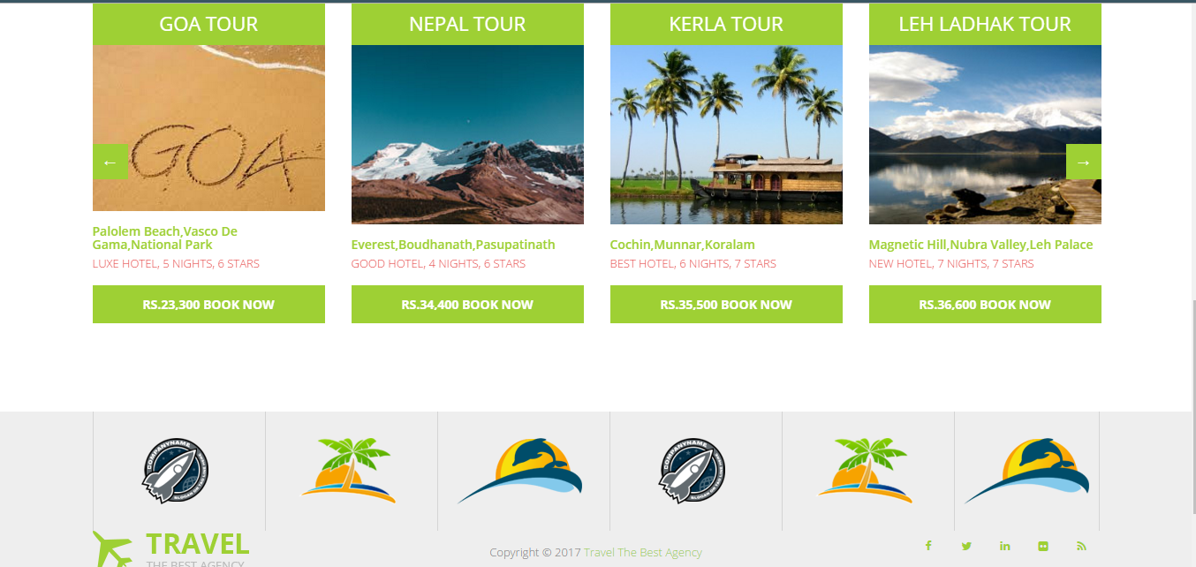
Tour pacakges(ii)

Slide 17
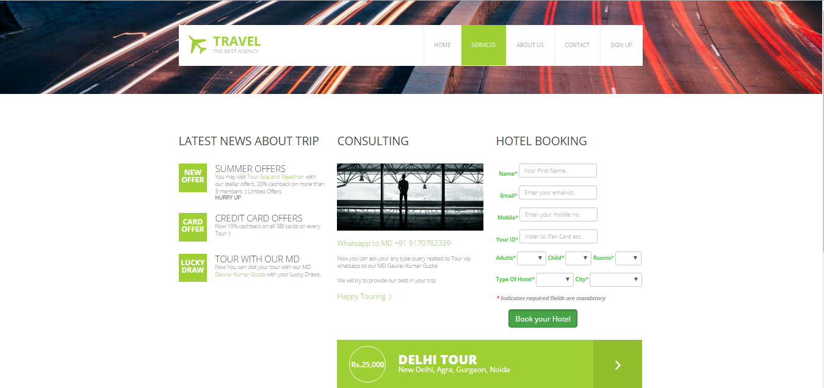
services

Slide 18
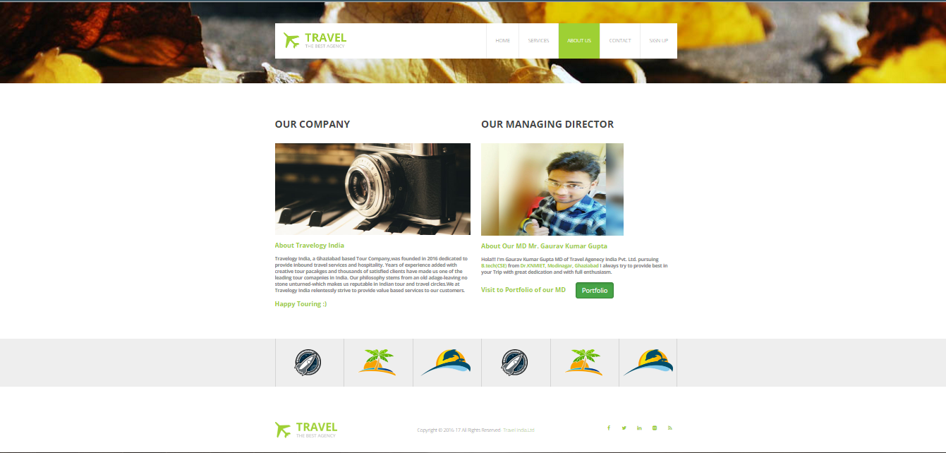
About us

Slide 19
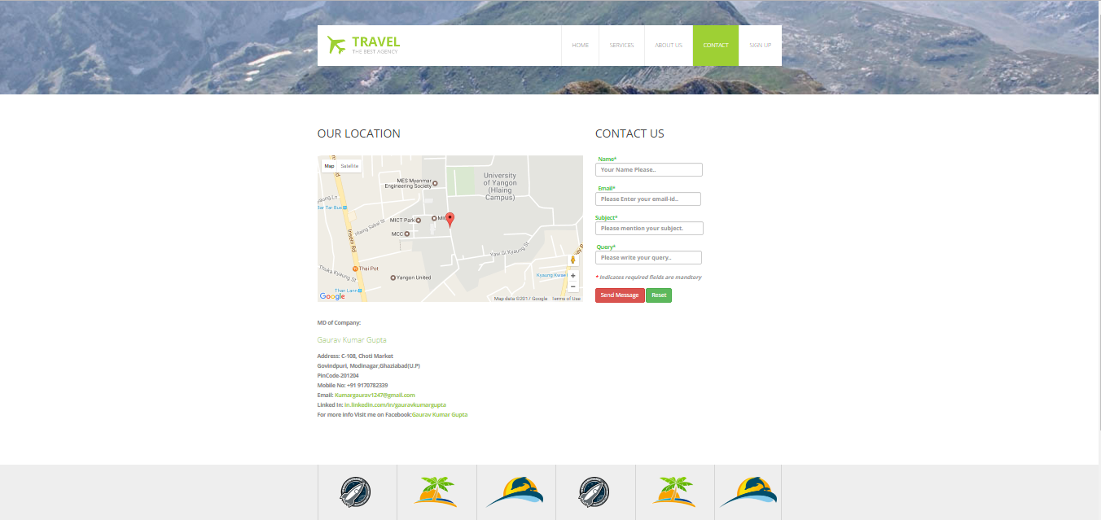
contact

Slide 20
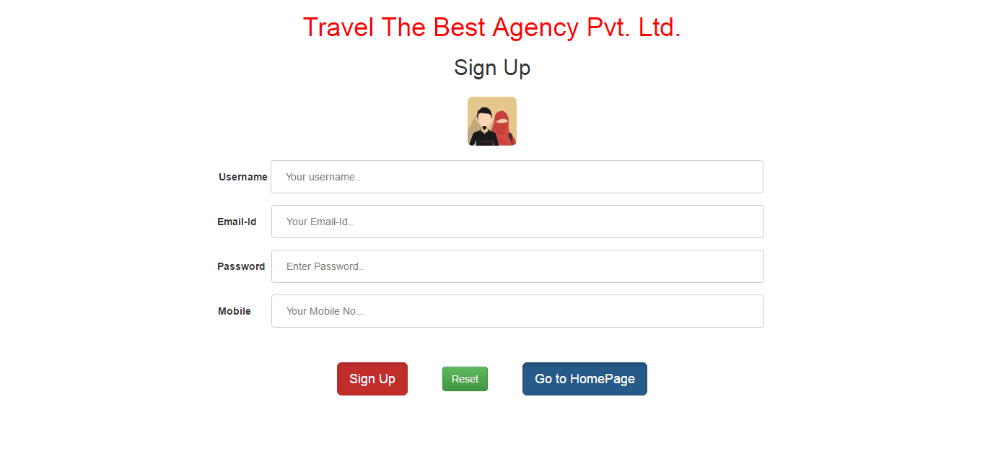
Sign up

Slide 21
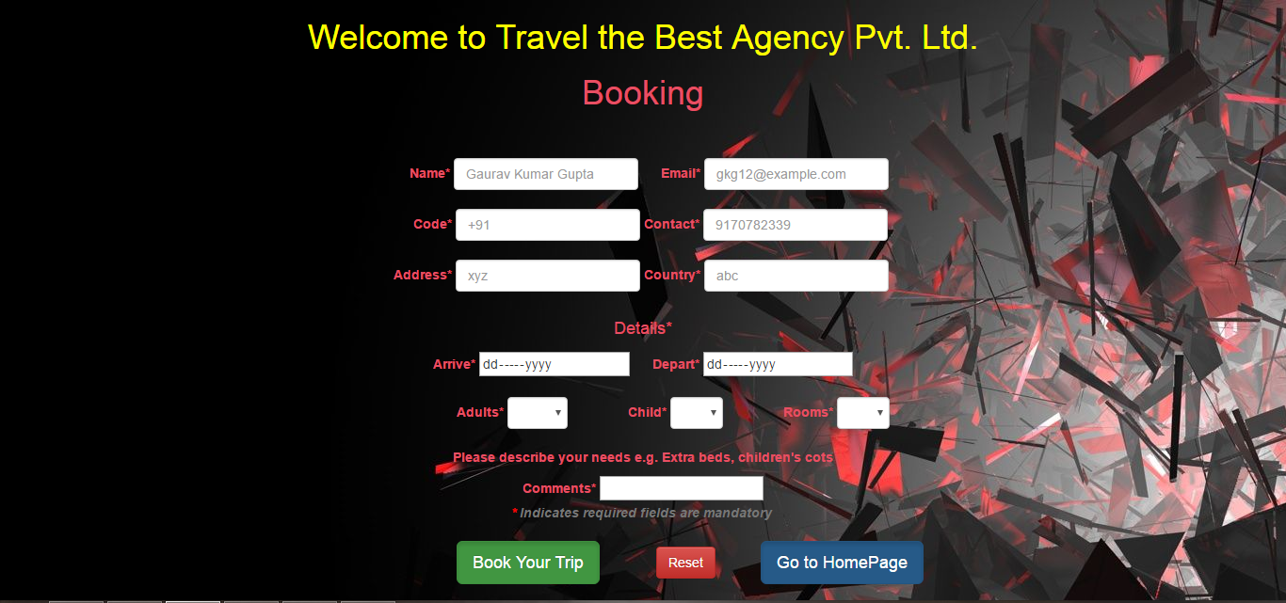
Booking page

Slide 22
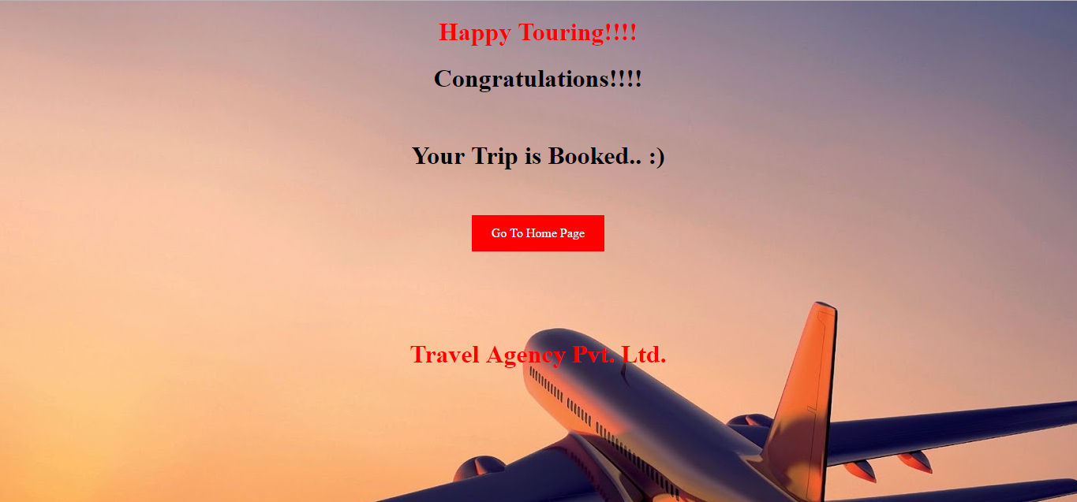
Booking confirmation

Slide 23
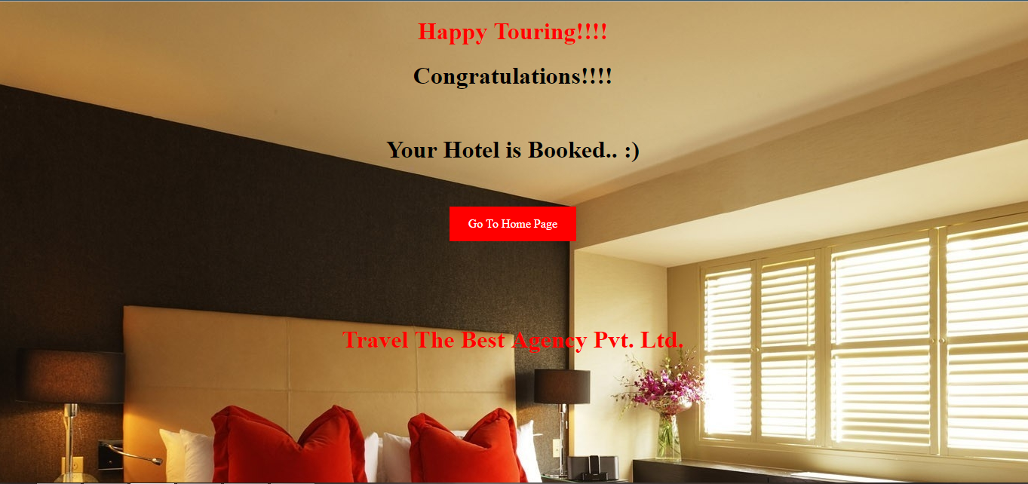
Hotel booking confirmation

Slide 24
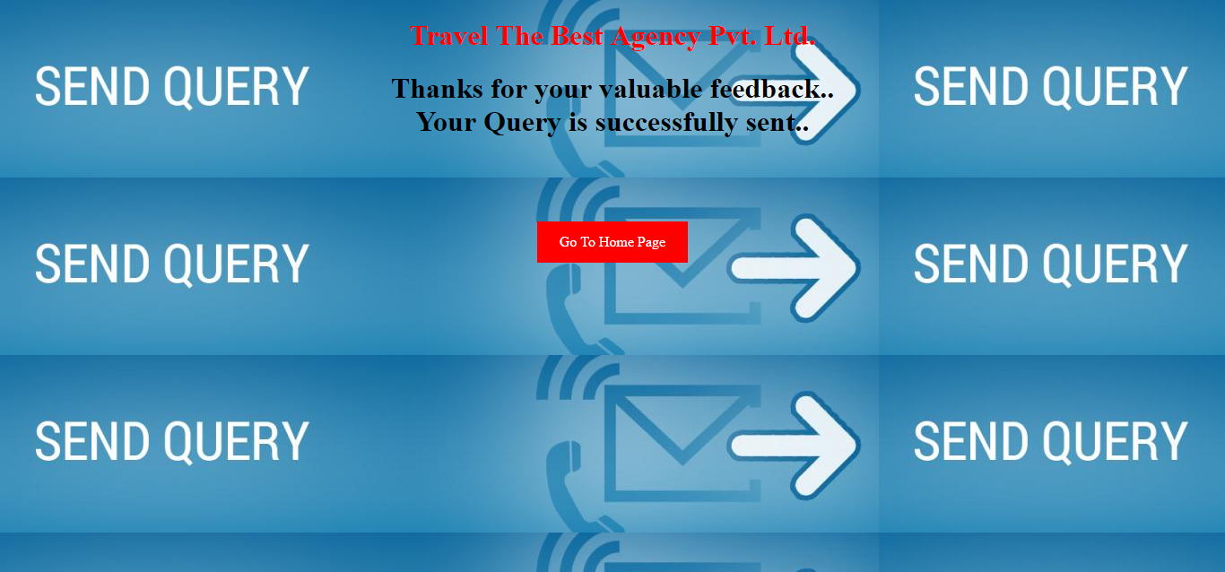
Query page

Slide 25
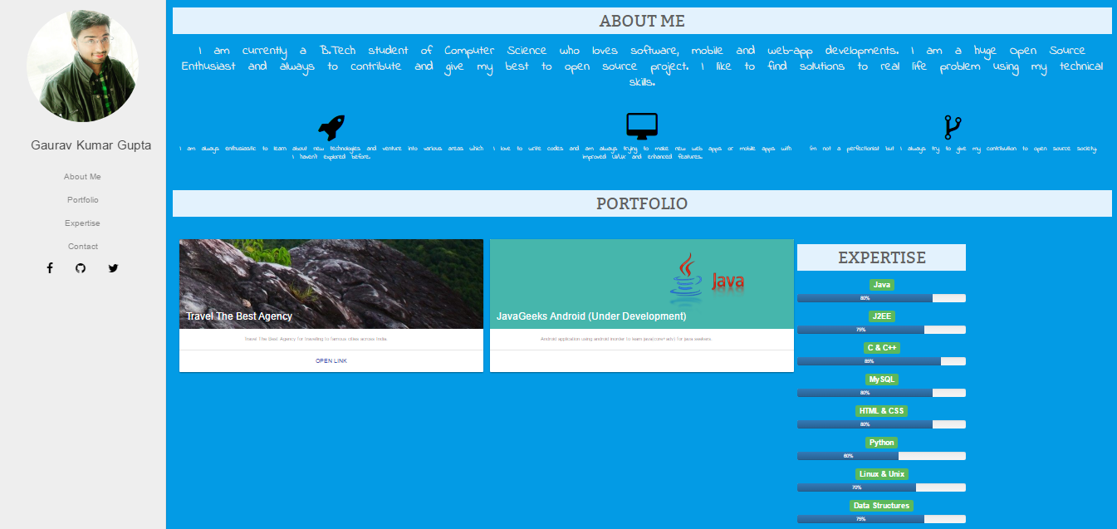
portfolio

Slide 26
REFERENCES
http://www.wikipedia.org/
http://www.travelogyindia.com/
https://www.google.co.in
http://www.realitytoursandtravel.com
http://www.indiatoursonline.com
Very Thankful to
Ms. Neha Gupta
Mr. Praveen kr. Gangwar

Slide 27

THANK YOU..☺☺

